Slide 1



QUANTUM COMPUTING
Where the tiniest things solve the biggest problems incredibly fast

Slide 2

CONTENTS
BITS AND QUBITS
QUANTUM GATES
SUPERPOSITION
ENTANGLEMENT

Slide 3
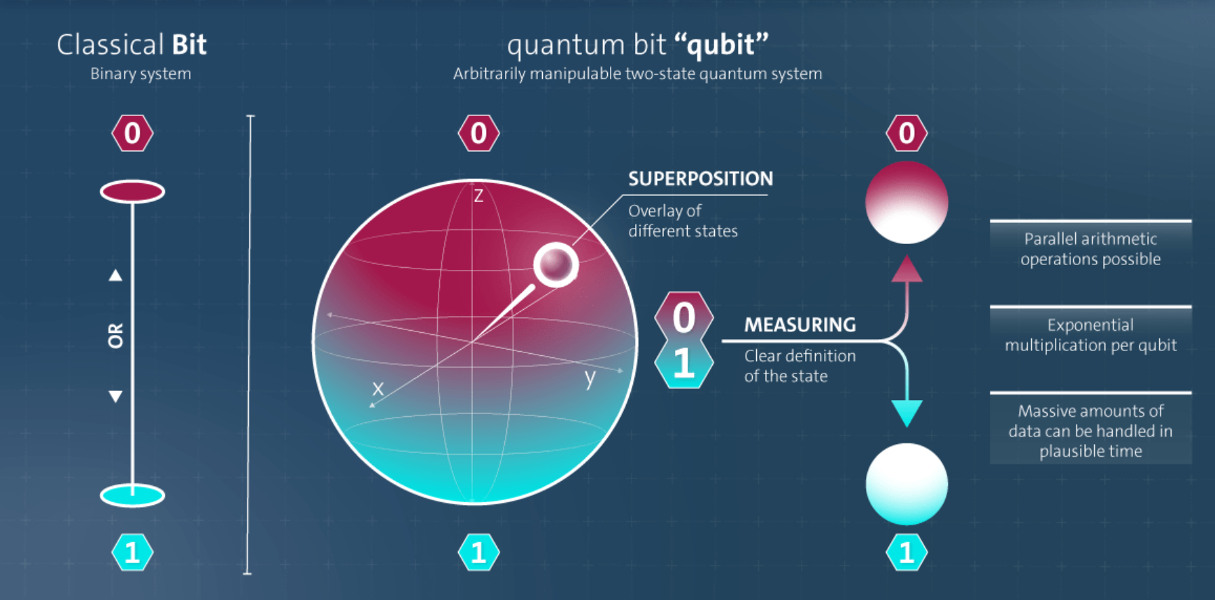

Slide 4
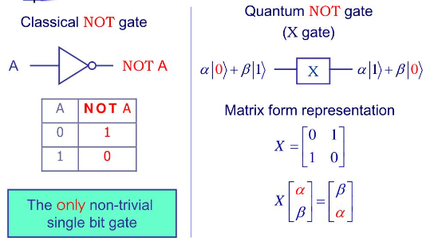
CLASSCIAL GATES VS QUANTUM GATES

Slide 5
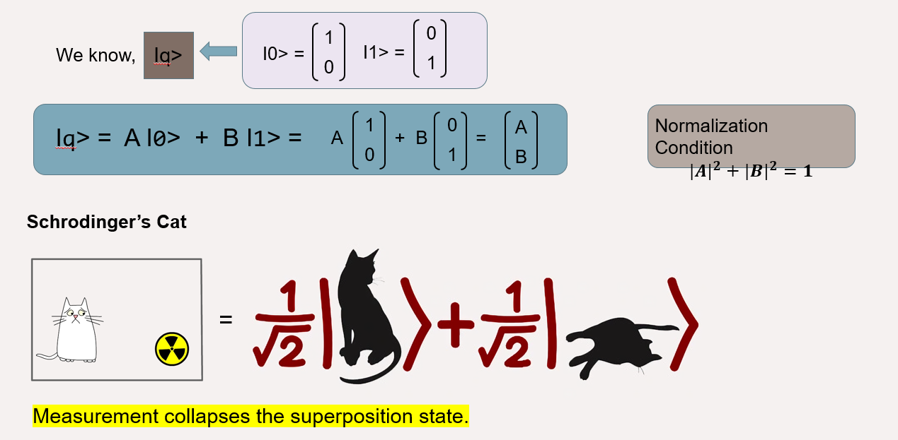
Quantum SUPERPOSITION

Slide 6
Quantum ENTANGLEMENT
Quantum entanglement is a quantum physics phenomenon where particles become interconnected, so their states are instantly linked, regardless of distance.

Slide 7
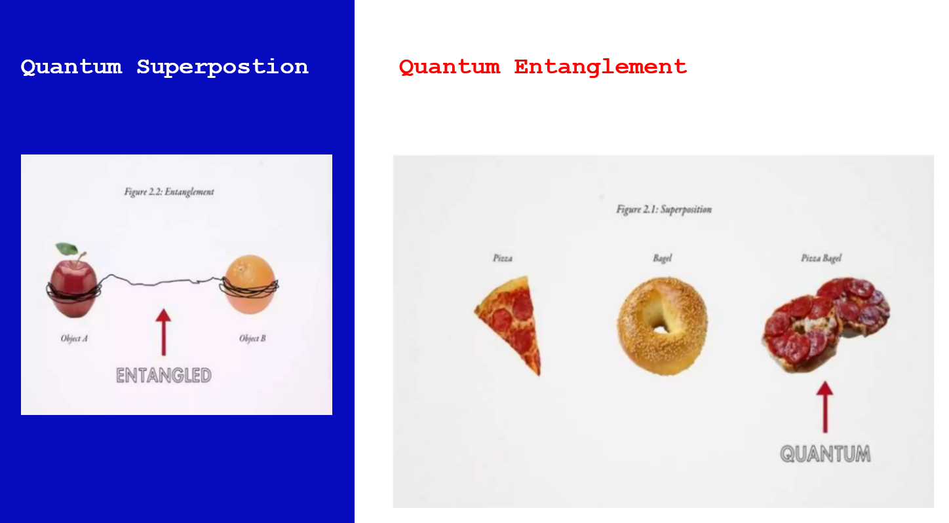



Slide 8
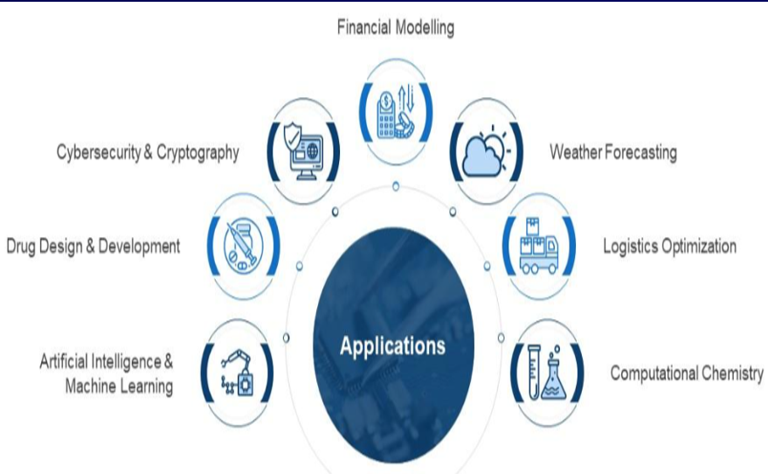
Quantum applications

Slide 9
Let’s build a quantum circuit??? using IBM Quantum Composer

